Slide 1
Introduction to Databases Checkpoint
SALHI KHALIL

Slide 2

What is MySQL ?
MySQL is the most popular open source SQL database. It is typically used for web application development, and often accessed using PHP.
The main advantages of MySQL are that it is easy to use, inexpensive, reliable (has been around since 1995), and has a large community of developers who can help answer questions.
Some of the disadvantages are that it has been known to suffer from poor performance when scaling, open source development has lagged since Oracle has taken control of MySQL, and it does not include some advanced features that developers may be used to.

Slide 3
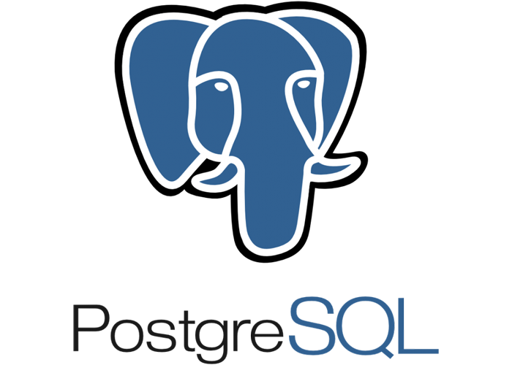
What is PostgreSQL ?
PostgreSQL is an open source SQL database that is not controlled by any corporation. It is typically used for web application development.
PostgreSQL shares many of the same advantages of MySQL. It is easy to use, inexpensive, reliable and has a large community of developers. It also provides some additional features such as foreign key support without requiring complex configuration.
The main disadvantage of PostgreSQL is that it can be slower in performance than other databases such as MySQL. It is also slightly less popular than MySQL.

Slide 4
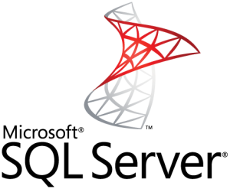
What is SQL SERVER ?
Microsoft owns SQL Server. Like Oracle DB, the code is close sourced.
Large enterprise applications mostly use SQL Server.
Microsoft offers a free entry-level version called Express but can become very expensive as you scale your application.

Slide 5
A comparison between the three RDBMS
MySQL | PostgreSQL | SQL Server
Open-Source | Open-Source | Licensed
Owned by Oracle | Owned by PostgreSQL Global Development Groupe | Owned by Microsoft
Scalable buffer pool to pull cache | Scalable buffer pool to pull cache | Isolate processes as separate OS processes
Limited functionality regarding tables to deal with complex processes | More functionality regarding temporary tables (divide tables into local and global), Better with complex processes | More functionality regarding temporary tables (divide tables into local and global), Better with complex processes
Organizes index into clusters and tables (not very flexible search) | Rich automated functionality for index management | Flexible search

Slide 6
THANK YOU

